Slide 1

テストエースレボート
Implementer: Ｈuynh Van Thanh
From 2018-01-10 to 2018-01-31
Version: TESTACE_V7.2.71201

Slide 2
Categories
Schedule Study
Overview
Setting
Data Flow
Conversion Type
Report
Summary
Thank you

Slide 3
Schedule study
WBS | タスク | 進捗 | 工数 | 予想開始日 | 予想終了日 | 実際開始日 | 実際終了日
1 | Test Ace Installation | 100% | 1 | 2018/1/10 | 2018/1/10 | 2018/1/10 | 2018/1/10
2 | Test Ace Operation | 100% | 1 | 2018/1/11 | 2018/1/11 | 2018/1/11 | 2018/1/11
3 | Setting
3.1 | DB connection info | 100% | 0.5 | 2018/1/12 | 2018/1/12 | 2018/1/12 | 2018/1/12
3.2 | File connection info | 100% | 0.5 | 2018/1/12 | 2018/1/12 | 2018/1/12 | 2018/1/12
4 | Data flow
4.1 | DB to File | 100% | 0.5 | 2018/1/15 | 2018/1/15 | 2018/1/15 | 2018/1/15
4.2 | DB to DB | 100% | 0.5 | 2018/1/15 | 2018/1/15 | 2018/1/15 | 2018/1/15
4.3 | Load | 100% | 0.5 | 2018/1/16 | 2018/1/16 | 2018/1/16 | 2018/1/16
4.4 | File to File | 100% | 0.5 | 2018/1/16 | 2018/1/16 | 2018/1/16 | 2018/1/16
4.5 | Generate to File | 100% | 0.5 | 2018/1/17 | 2018/1/17 | 2018/1/17 | 2018/1/17
4.6 | Generate to DB | 100% | 0.5 | 2018/1/17 | 2018/1/17 | 2018/1/17 | 2018/1/17
5 | Conversions type
5.1 | Unchanged | 100% | 0.5 | 2018/1/18 | 2018/1/18 | 2018/1/18 | 2018/1/18
5.2 | Mask | 100% | 0.5 | 2018/1/18 | 2018/1/18 | 2018/1/18 | 2018/1/18
5.3 | Random [DB to File, DB to DB] | 100% | 0.5 | 2018/1/19 | 2018/1/19 | 2018/1/19 | 2018/1/19
5.4 | Random [Generate to File, Generate to DB] | 100% | 0.5 | 2018/1/19 | 2018/1/19 | 2018/1/19 | 2018/1/19
5.5 | Gizidata [DB to File, DB to DB] | 100% | 0.5 | 2018/1/22 | 2018/1/22 | 2018/1/22 | 2018/1/22
5.6 | Gizidata [Generate to File, Generate to DB] | 100% | 0.5 | 2018/1/22 | 2018/1/22 | 2018/1/22 | 2018/1/22
5.7 | Use-defind function | 100% | 0.5 | 2018/1/23 | 2018/1/23 | 2018/1/23 | 2018/1/23
5.8 | Foreign key | 100% | 0.5 | 2018/1/23 | 2018/1/23 | 2018/1/24 | 2018/1/24
5.9 | Dependent column | 100% | 0.5 | 2018/1/24 | 2018/1/24 | 2018/1/24 | 2018/1/24
5.10 | Sequence number | 100% | 0.5 | 2018/1/24 | 2018/1/24 | 2018/1/25 | 2018/1/25
5.11 | Fixed value | 100% | 0.5 | 2018/1/25 | 2018/1/25 | 2018/1/25 | 2018/1/25
6 | Gizidata info | 100% | 1 | 2018/1/25 | 2018/1/26 | 2018/1/26 | 2018/1/26
7 | User defined function info | 100% | 2 | 2018/1/26 | 2018/1/30 | 2018/1/29 | 2018/1/30
8 | Test Ace Report
8.1 | Reparing report document | 100% | 1 | 2018/1/30 | 2018/1/31 | 2018/1/31 | 2018/2/1
8.2 | Reporting | 100% | 0.5 | 2018/1/31 | 2018/1/31 | 2018/2/2 | 2018/2/2
Notes:
Test Ace Installation Guide Confirmation
Test Ace Operation Guide Confirmation
Test ace setting document guide confirmation
Execute installation
Check the contents of the installation guide
Test ace operation check
Confirm the contents of the test ace operation guide
Confirm the contents of the test ace setting guide guide
Test Ace Product Description
Test ace Preparation of product description (Prepare Report)
Test Ace Product Description (Reporting)

Slide 4
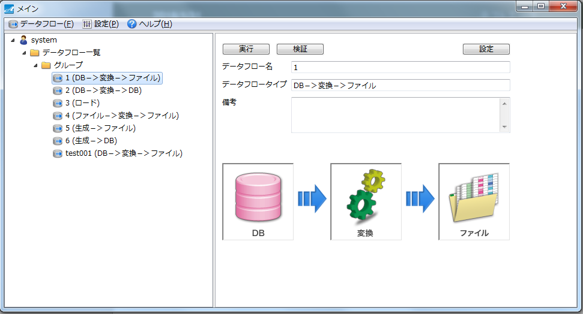
II. Overview
テストエースis a software used for create data in order to test product.
It create data base on data of database or file (CSV, Excel) or auto create.
Data is created converted that is similar real data.
User can custom data creation by rules.
Creating and converted data is sure for real data information.
Output createing or converted data to database or file (CSV, EXCEL).
Support 3 database: Oracle, MSSQLServer, PostgreSQL.
Notes:
Java learning
Building Eclipse
File I / O
Database I / O
Test Ace User Defined Function
"Creating user-defined functions
When there is a primary key constraint in the DB before conversion data,
Consider the transformation that keeps unique even after conversion “
User defined function examination

Slide 5
III. Setting
Configuration info before creating data:
Database connection
File connection
Gizidata
User Function

Slide 6
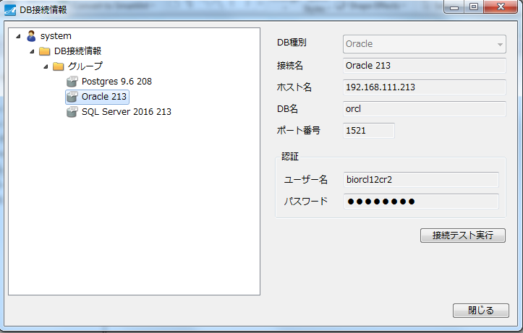
III. Setting (Next)
1. Database connection.
  Allow set info to connect to database.
  While TestAce is creating data, database’s info can be input or output.

Slide 7
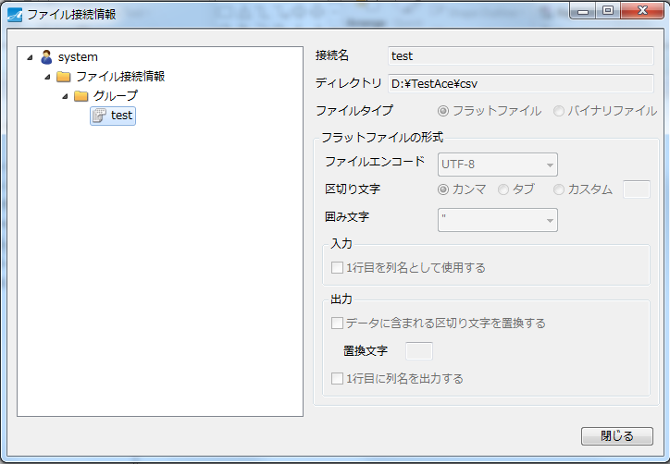
III. Setting (Next)
2. File connection.
  Setting output information.
  Output data to setting directory.

Slide 8
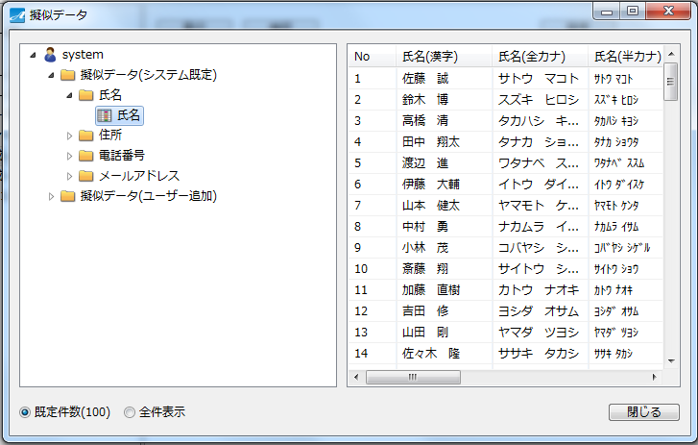
III. Setting (Next)
3. Gizidata.
  It is a pattern data in order to prepare to create new data.
  Created data base on this gizidata.

Slide 9
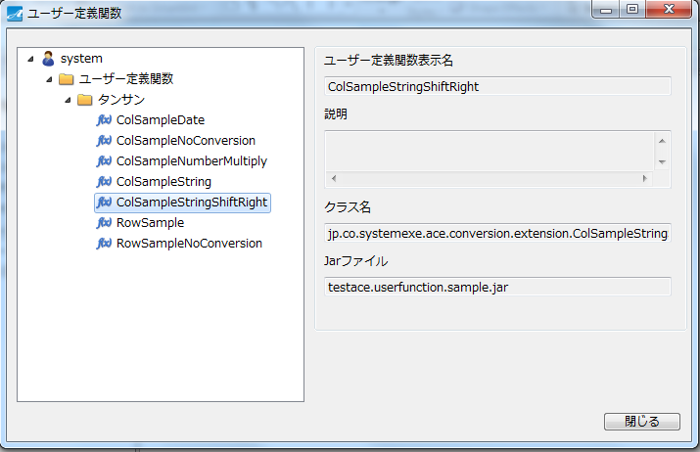
III. Setting (Next)
3. User Function.
  Users will define some function which is way creating data.
  This setting allow connect functions which users defined.

Slide 10
IV. Data Flow
Data Flow List：
DB－＞変換－＞ファイル
DB－＞変換－＞DB
ロード
ファイル－＞変換－＞ファイル
生成－＞ファイル
  Output data to file (CSV, EXCEL).
生成－＞DB
  Output data to database.

Slide 11
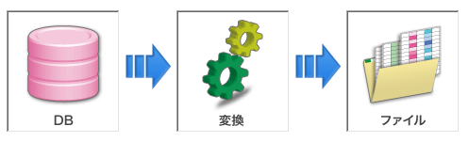
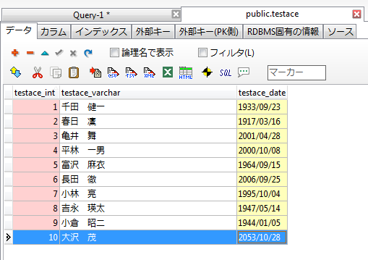
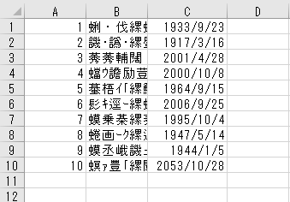
VI. Data Flow (Next)
1. DB－＞変換－＞ファイル
  Created data base on data of database.
  Output data to file (CSV, EXCEL).
Setting unchange
11
Data input [database]
Data output [file]

Slide 12
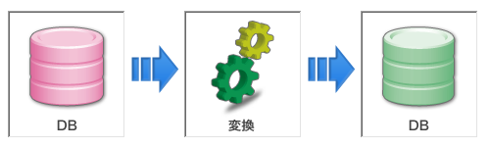
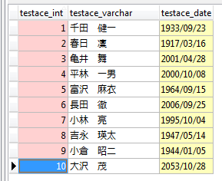
VI. Data Flow (Next)
2. DB－＞変換－＞DB
  Created data base on data of database.
  Output data to database.
Data input [database]
Data ouput [database]
Setting unchange

Slide 13
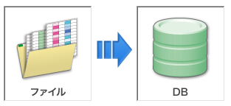
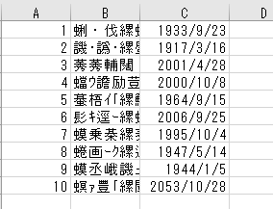
VI. Data Flow (Next)
3. ロード
  Created data base on data of file (CSV, EXCEL).
  Output data to database.
Data input [file]
Data ouput [database]

Slide 14
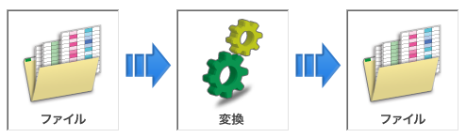
VI. Data Flow (Next)
4. ファイル－＞変換－＞ファイル
  Created data base on data of file (CSV, EXCEL).
  Output data to file (CSV, EXCEL).
Data input [file]
Data output [file]
Setting unchange

Slide 15
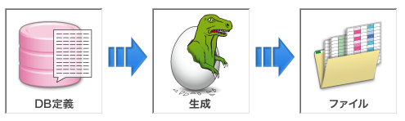
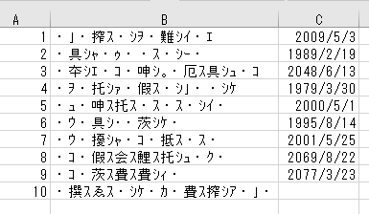
VI. Data Flow (Next)
5. 生成－＞ファイル
  Created data don’t base on database’s data
  Output data to file (CSV, EXCEL).
Data input [database]
Data output [file]
Setting unchange

Slide 16
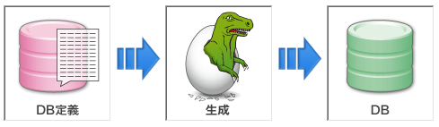
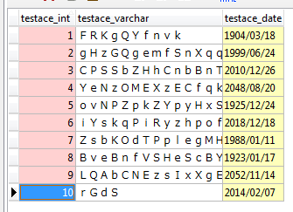
VI. Data Flow (Next)
6. 生成－＞DB
  Created data don’t base on database’s data
  Output data to database.
Data input [database]
Data output [database]
Setting unchange

Slide 17
V. Conversion Type
Conversion type list:
Unchanged
Mask
Random
Gizidata
Use-defind function
Foreign key
Dependent column
Sequence number
Fixed value

Slide 18
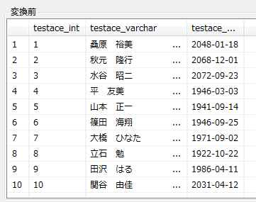
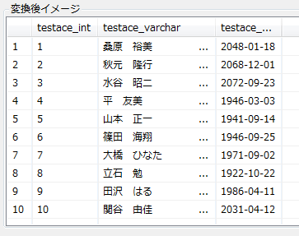
V. Conversion Type (Next)
1. Unchanged:
Created data like real data in database or file.

Slide 19
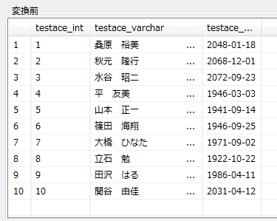
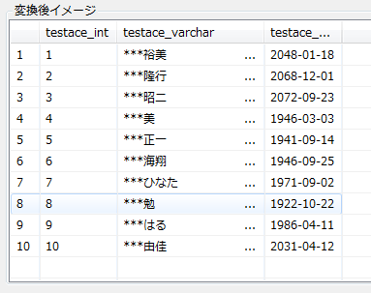
V. Conversion Type (Next)
1. Mask:
Created data do not like real data in database or file.
Data are replaced some things by setting.

Slide 20
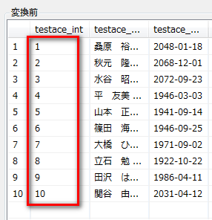
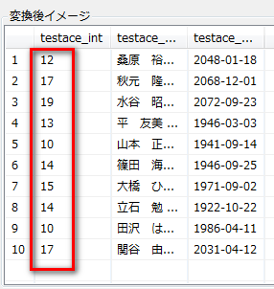
V. Conversion Type (Next)
1. Random:
Created data do not like real data in database or file.
Data are created base on setting.

Slide 21
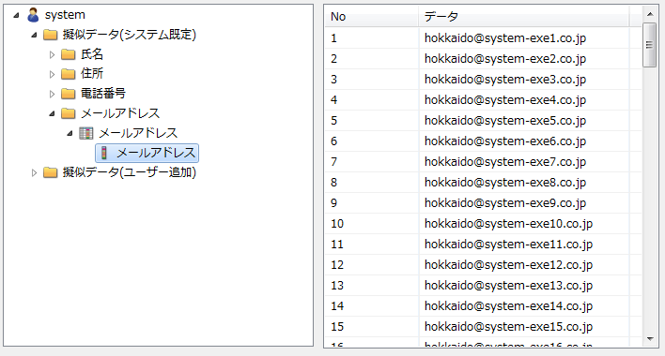
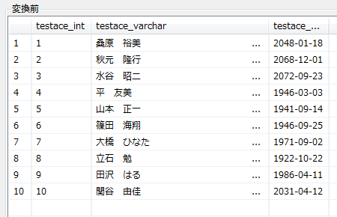
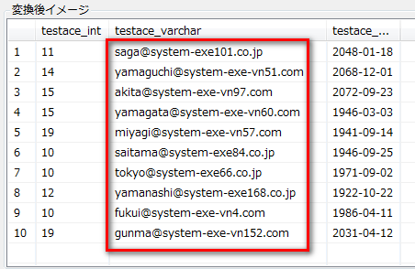
V. Conversion Type (Next)
1. Gizidata:
Created data base on file data.
File Gizidata

Slide 22
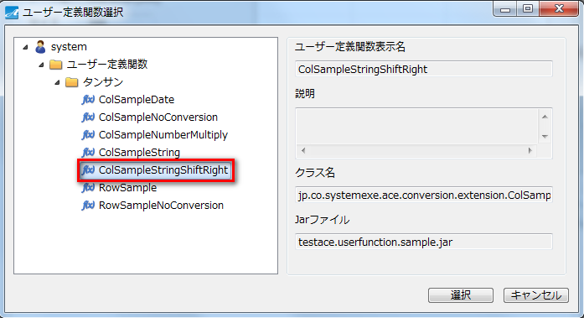
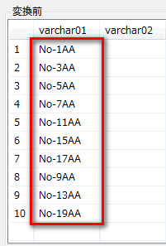
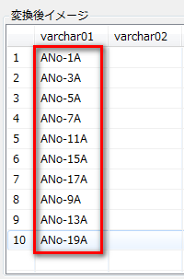
V. Conversion Type (Next)
1. Use-defind function:
Created data base on created function of user.
Created function of User

Slide 23
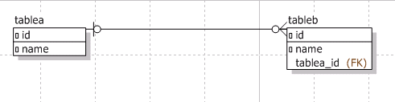


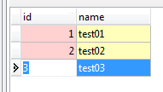
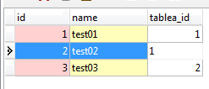
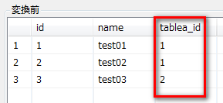
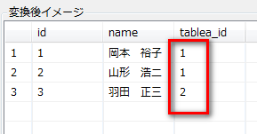
V. Conversion Type (Next)
1. Foreign key:
Convert data like data in database.

Slide 24
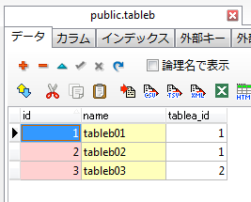
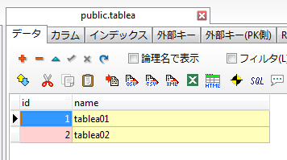
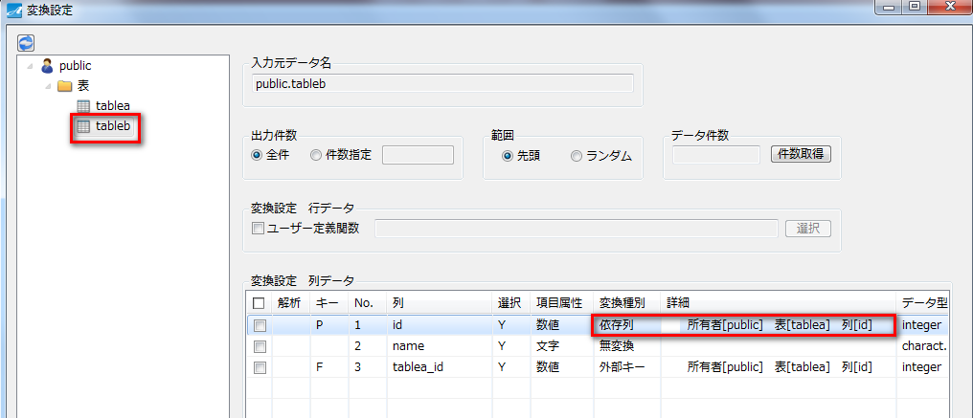
V. Conversion Type (Next)
1. Dependent column:
Created data is the same with dependent columns

Slide 25
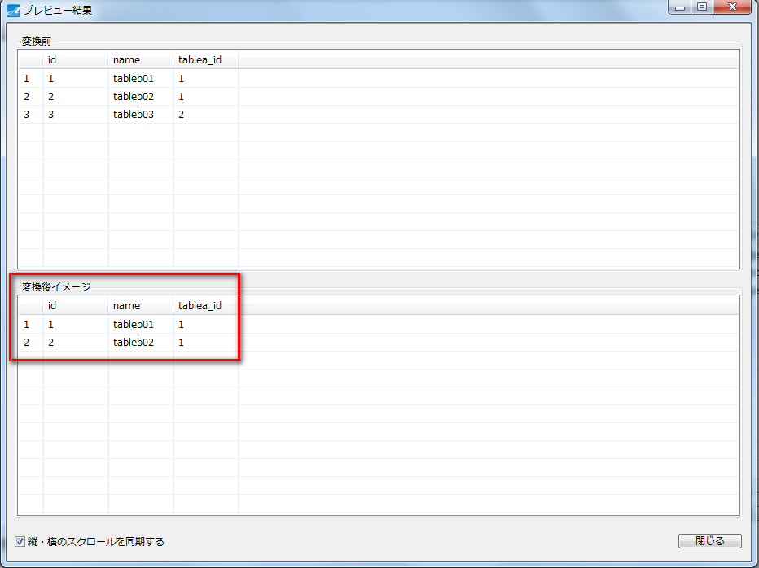
V. Conversion Type (Next)

Slide 26
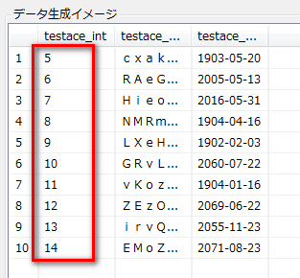
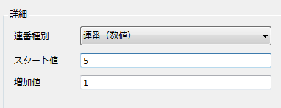
V. Conversion Type (Next)
Sequence Ｎumber:
Generate a sequence number.

Slide 27
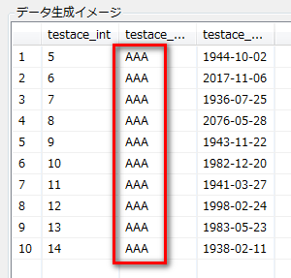

V. Conversion Type (Next)
Fixed Ｖalue:
Generate fixed value.

Slide 28
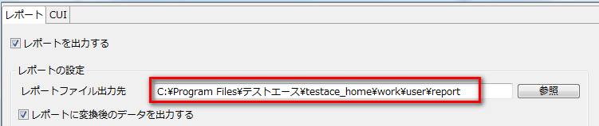
VI. Report
  Users can make settings for outputting report.
  Report show information while TestAce is creating data.

Slide 29
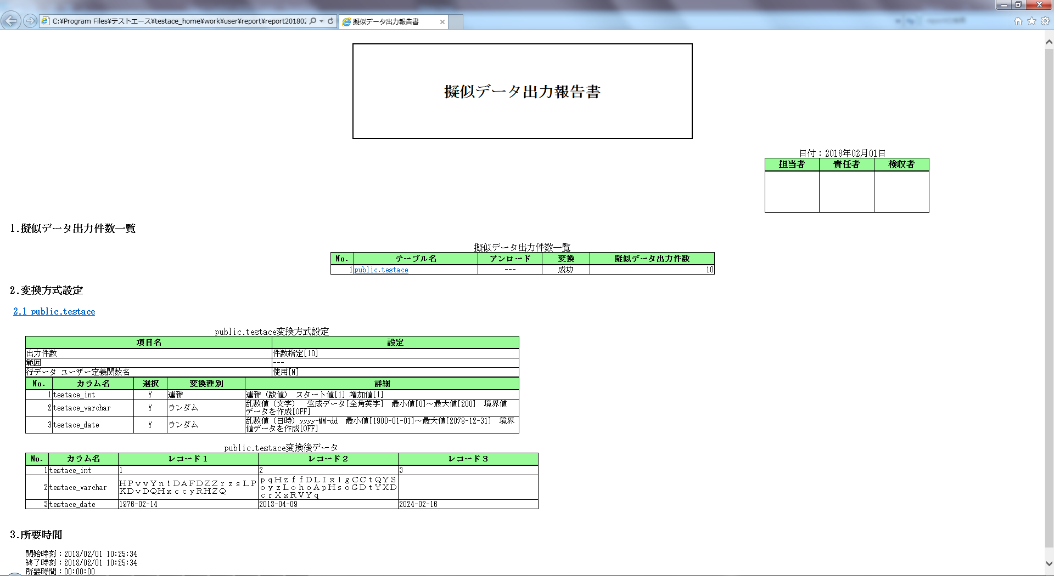
VI. Report (Next)

Slide 30


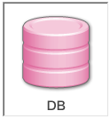
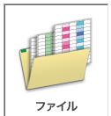

VII. Summary
Input
Output

Slide 31
VIII. Thanks your watching

